Slide 1
HTCS6703 Network Security Breach Simulation Demonstration
By Oliver Smith, Ava Richards, Vivien Shen, Youngkwang Kweon

Slide 2
Overview
Why?
Tools
Process

Slide 3
Why?
To test the strength of Windows Defender from Lumma Stealer malware
Logging and Alerting with Wazuh
Simulating an Adversary Attack with AttackIQ
30 scenarios of Lumma Stealer malware aligned with MITRE ATT&CK Framework

Slide 4




Tools

Slide 5
System
Two virtual machines running from VirtualBox
Machine 1: Wazuh Server
Machine 2: Windows 11 w/ Wazuh Agent
Wazuh and Windows Defender for EDR system
AttackIQ Flex for Attack simulator

Slide 6
Technical Process
Send
Send Windows Defender logs to Wazuh Server
Run
Run simulation with AttackIQ Flex
Check
Check alerts within Wazuh
Check
Check the AttackIQ Flex report

Slide 7
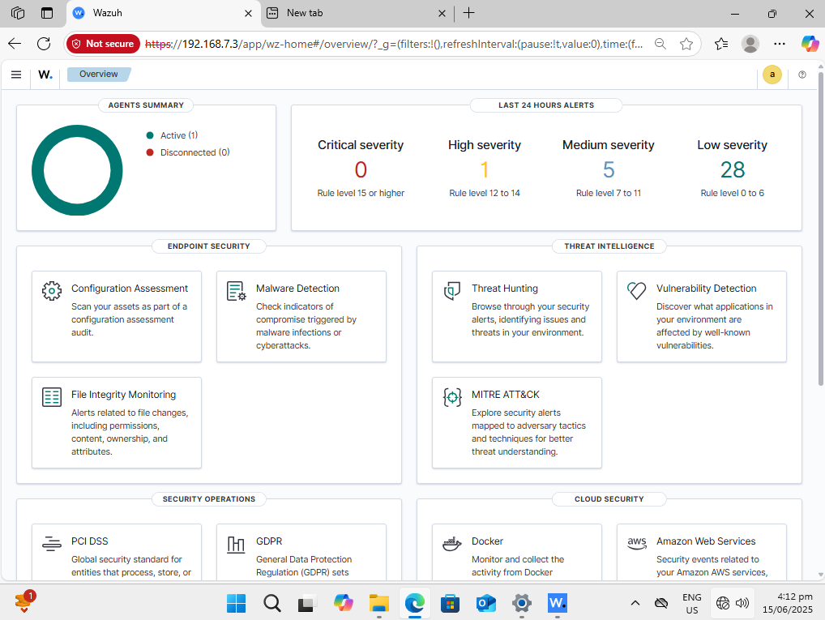
Wazuh Dashboard

Slide 8
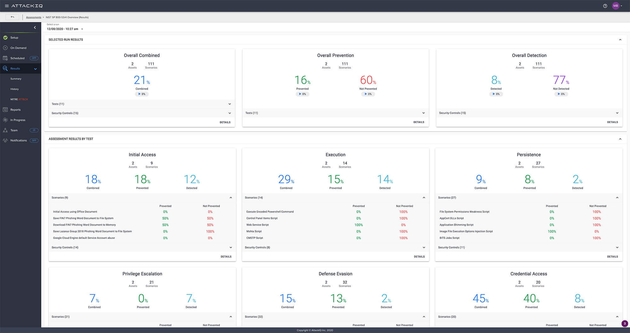
AttackIQ Dashboard

Slide 9
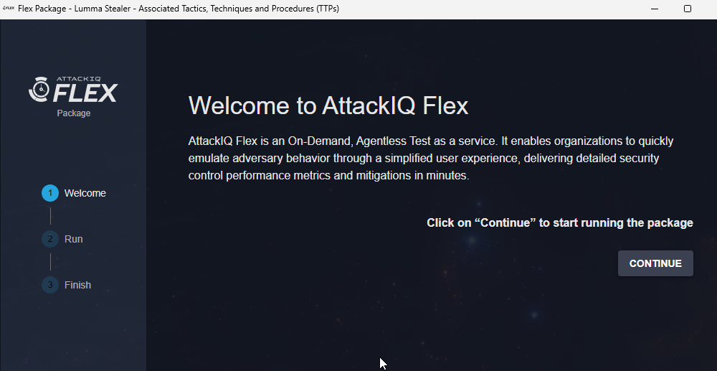
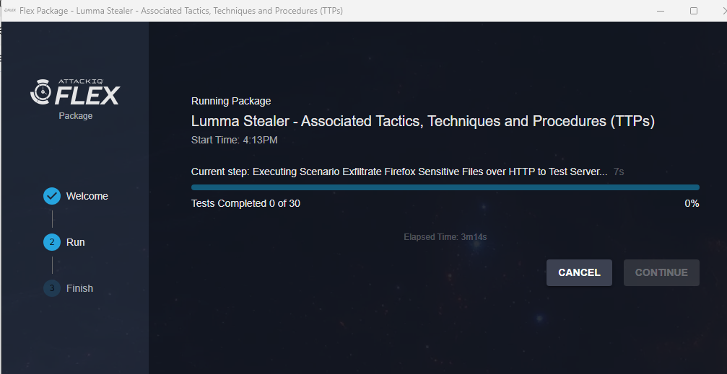
AttackIQ Flex

Slide 10
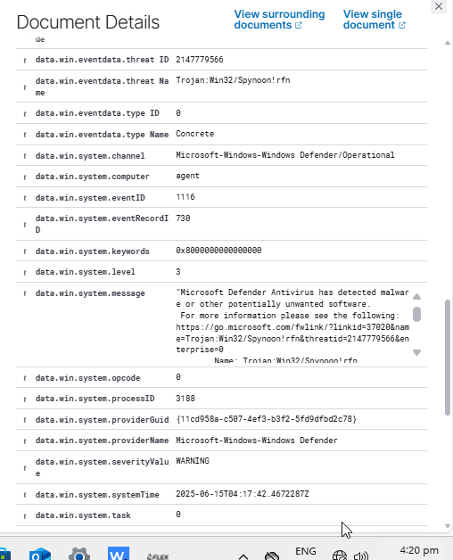
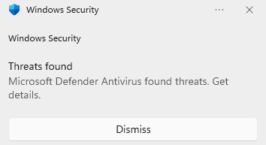
Alerting
Wazuh alert details

Slide 11
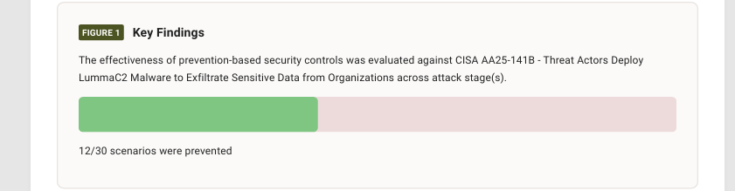
Results
From the AttackIQ report

Slide 12
Result
What did we find?
12 out of 30 scenarios were blocked from Windows Defender
What didn't Windows Defender pick up?
Windows Defender didn't pick up Lumma Stealer saved to Memory
Was able to download payload via Mshta (T1218.005)
What can we see on the Wazuh?
We can see all the alerts from Windows Defender

Slide 13
Conclusion
What can we do going forward?
Reduce account permissions and disable unused applications.
Filter Network Traffic
Feed Powershell logs into Wazuh for better monitoring when it comes to detecting:
T1059.001, T1027

Slide 14
Up next, Business presentation

